Slide 1
Introduction to Machine Learning with WEKA
September 29, 2022
https://github.com/niaid/bcbb-training-intro-to-machine-learning
Daniel Veltri, Ph.D.

Slide 2
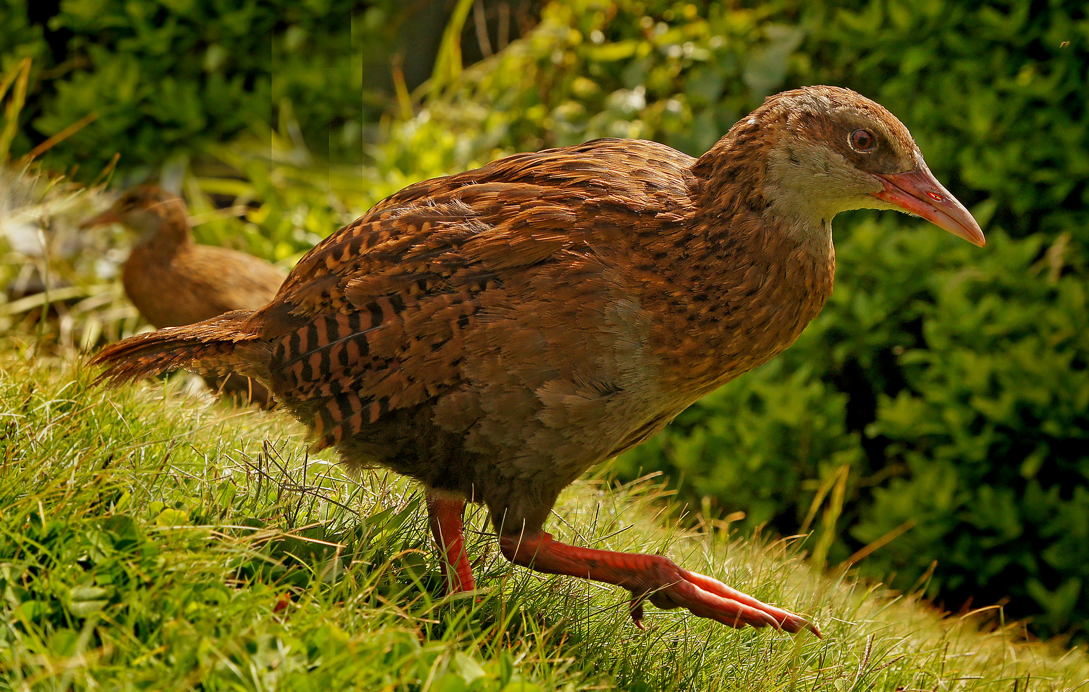
What is a WEKA?
This bird native to New Zealand
Photo By: Bernard Spragg - https://www.flickr.com/photos/volvob12b/10220994444

Slide 3
Today we will be using this WEKA…
Free and open source software
Java-based: works on Windows, Mac, and Linux
Has many statistical and machine learning methods to cluster data and make predictions
Has an easy-to-use interface for data exploration and experimentation
For advanced users: supports command-line interface and Weka libraries can work with any Java code

Slide 4
What is Machine Learning (ML)?
The field of ML stems from research on Artificial Intelligence (AI) in the 1950’s. Back then the goal was to replicate tedious human tasks using explicit rules (algorithms):
[Data + Rules => Answers],
ML’s goal is to have a computer learn to teach itself an algorithm that produces a useful approximation of data:
[Data + Answers => Rules],
Buzzwords like “Deep Learning,” “Decision Trees,” ”Support Vector Machines,” etc. are subfields of ML.

Slide 5
Basic Idea of an Algorithm
A set of rules
INPUT DATA
(X)
OUTPUT
RESPONSE
(Y)
ALGORITHM(S)
Notes:
WEKA refers to input data features as “attributes”

Slide 6
Basic Idea of an Algorithm
+1
1
2
INPUT DATA
(X)
A set of rules
OUTPUT
RESPONSE
(Y)
ALGORITHM(S)

Slide 7
Basic Idea of an Algorithm
+1
<1,5,10>
<2,6,11>
INPUT DATA
(X)
OUTPUT
RESPONSE
(Y)
ALGORITHM(S)

Slide 8
Basic Idea of Learning an Algorithm
?
<1,5,10>
<2,10,20>
Multiply
x2
INPUT DATA
(X)
OUTPUT
RESPONSE
(Y)
ALGORITHM(S)
This is a regression problem of the form: y = wx + w₀
We’re fitting a function that maps INPUT → OUTPUT
y = 2x + 0

Slide 9
Basic Idea of Learning an Algorithm
Is Bird?
?
TRUE
Has wings?
&
Has beak?
INPUT DATA
(X)
OUTPUT
RESPONSE
(Y)
ALGORITHM(S)
This is a classification problem! Typically these produce binary (limited to 2 topics) or categorical (multi-topic) outputs

Slide 10
Basic Idea of Learning an Algorithm
Dear Sir/Madam,
You have won a free vacation!
Please click this link to claim your prize:
http://www.scarywebsite.info
?
No specific name?
and/or
Free vacation?
and/or
Has .info link?
99.9%
OUTPUT
RESPONSE
(Y)
ALGORITHM(S)
INPUT DATA
(X)
This is another classification problem with numerical (prediction probabilities) output

Slide 11
Supervised Learning
The previous examples of ML algorithms were “supervised learning” – where we train our approach using both example INPUT and example OUTPUT.
You can now take your trained approach (a “model”) and use it to make predictions on new (unseen) data!
There is also “unsupervised learning” – where we only use the INPUT and a specific set of rules to produce OUTPUT.

Slide 12
An Unsupervised Clustering Algorithm Example …
x
x
x
x
x
x
x
x
x
Our initial input points ... (typically we would give the program X/Y coordinates)

Slide 13
An Unsupervised Clustering Algorithm Example …
x
x
x
x
x
x
x
x
x
The output after clustering...
What might the rules be?

Slide 14
An Unsupervised Clustering Algorithm Example …
x
x
x
x
x
x
x
x
x
This is an example of “k-Nearest Neighbor” (k-NN) clustering with k = 3. It chooses the k nearest neighboring points to form a cluster.

Slide 15
Some Examples of ML in Bioinformatics
Cluster patients with similar phenotypes
Look for similar genes in a DNA database and predict what type of organism it came from
Predict the function of a newly discovered protein or virus
Identify promising targets for new drug development from a huge database of compounds
Any other ideas???

Slide 16
Keep in Mind the Limits of Predictive Models…
Leonard Koppet in the 70’s noticed a pattern- when an (American) Football team from a certain conference won the Super Bowl (Championship Match), the stock market went up that year!
Over the last 50 years this “model” has had an 80% success rate.
Remember, machine learning algorithms love to pick up on patterns… and correlation does not always mean causation!

Slide 17
Keep in Mind the Limits of Predictive Models…
Even advanced “Deep Learning” techniques are not perfect:
This creation by Google Photos’ “Assistant” has recently been a running joke online.
Images by: Alex Harker

Slide 18
So how do we set up ML experiments?

Slide 19
Setting Up a Supervised ML Experiment
TRAIN
~40%
TUNE ~20%
TEST
~40%
ALL DATA
100%
Gather representative data
Split into Training, Tuning and Testing partitions
Train a model and use Tuning partition like “Testing” while adjusting model parameters
Merge Training + Tuning and Train your final model
Run final model on Testing partition and evaluate
Train and Evaluate
Adjust Parameters
TRAIN
~40%
TUNE ~20%
COMBINED TRAIN
60%

Slide 20
K-Fold Cross Validation Experiments
ALL DATA
100%
TRAINING FOLDS
FOLD
1
FOLD
2
FOLD
3
FOLD
4
FOLD
5
FOLD
6
FOLD
7
FOLD
8
FOLD
9
FOLD
10
TESTING FOLD
Use K-1 folds for training and 1 for testing
Split data into K Folds (K is typically 3, 5, or 10)
Rotate until each fold is used for testing once.
Report results as the average over ALL tests!

Slide 21
How Much Training is Enough?
Over-fitting: Training our model too much!
We are making it fit the training data so well that
it does not generalize well to new (unseen) points,
Notes:
Dots might be training or validation data – shouldn’t look at testing yet!

Slide 22
How Much Training is Enough?
Over-fitting: Training our model too much!
We are making it fit the training data so well that
it does not generalize well to new (unseen) points,
Under-fitting: Our model is missing key parameters needed to model the data- typically this means you need to perform more training,

Slide 23
How Much Training is Enough?
Over-fitting: Training our model too much!
We are making it fit the training data so well that
it does not generalize well to new (unseen) points,
Under-fitting: Our model is missing key parameters needed to model the data- typically this means you need to perform more training,
Regularization: Relax our requirements so that we allow some errors in the training. We hope this means we will perform better on new points.

Slide 24
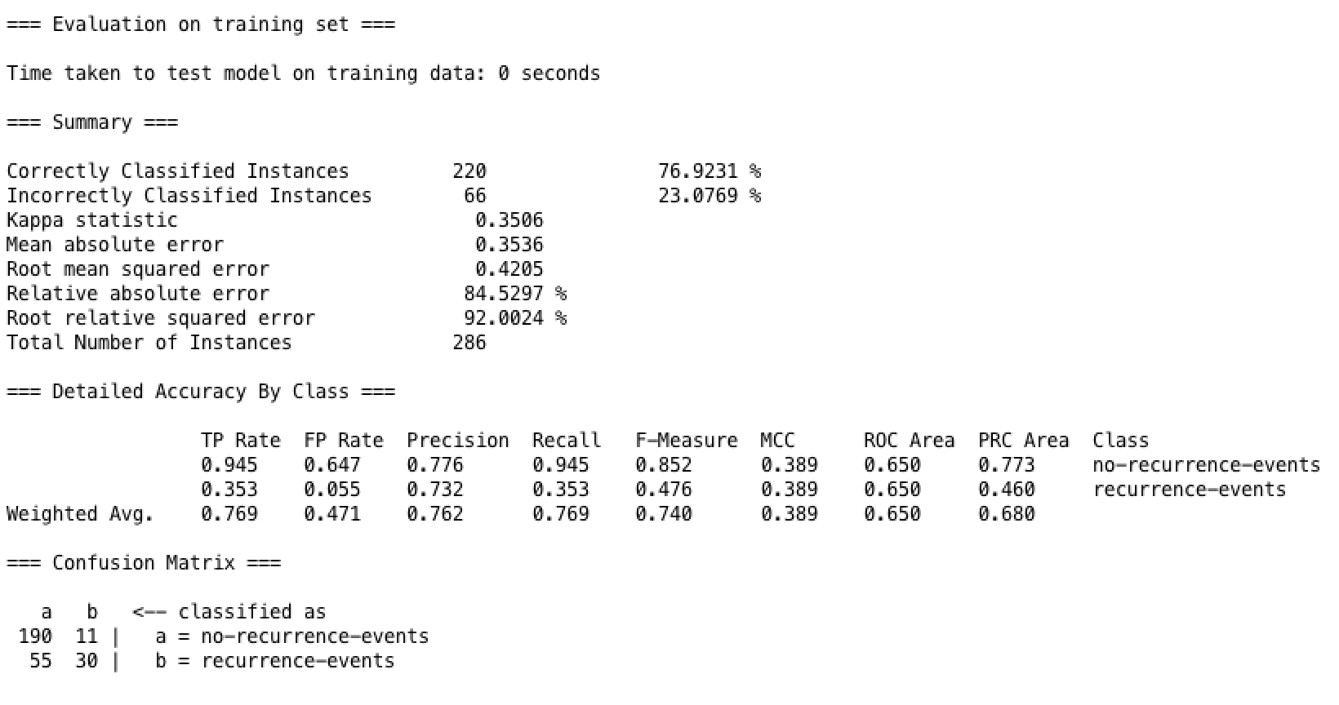
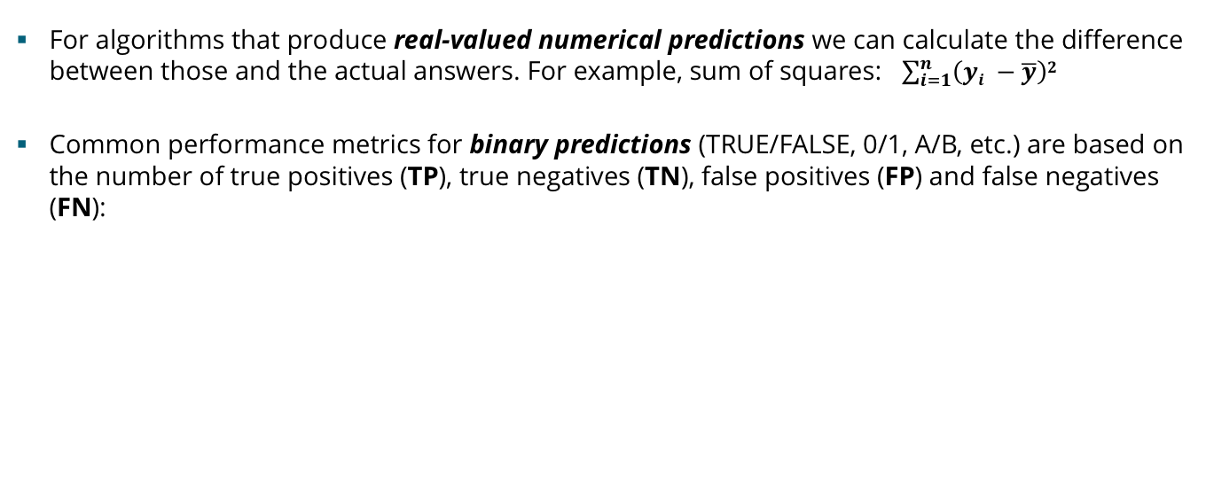
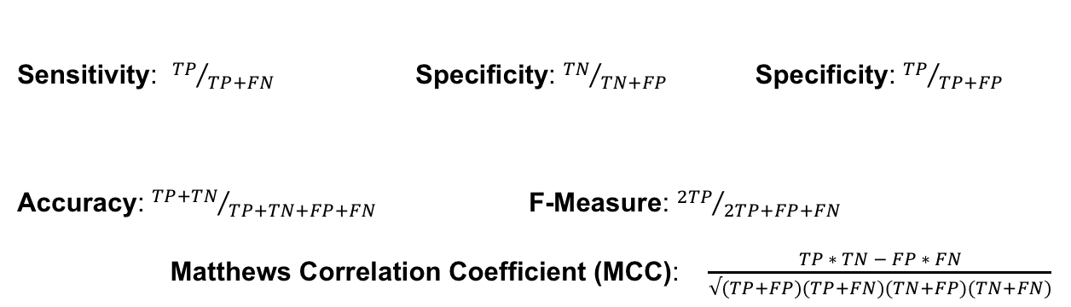
Evaluating Model Performance
WEKA
RESULTS
For algorithms that produce real-valued numerical predictions we can calculate the difference between those and the actual answers. For example, sum of squares: $\sum_{i=1}^{n}{\left(yi −\overline{y}\right)2}$
Common performance metrics for binary predictions (TRUE/FALSE, 0/1, A/B, etc.) are based on the number of true positives (TP), true negatives (TN), false positives (FP) and false negatives (FN):
Sensitivity: ${TP}/{TP+FN}$ Specificity: ${TN}/{TN+FP}$ Specificity: ${TP}/{TP+FP}$
Accuracy: ${TP+TN}/{TP+TN+FP+FN}$ F-Measure: ${2TP}/{2TP+FP+FN}$
Matthews Correlation Coefficient (MCC): $\frac{TP ∗ TN − FP ∗ FN}{√(TP+FP)(TP+FN)(TN+FP)(TN+FN)}$
(aka True Positive Rate or Recall)
(aka False Positive Rate)
Notes:
SENS: [0,1], SPEC: [0,1], ACC: [0,1] * 100%, F1: [0,1], MCC [-1,1]
Kappa stat - which agreement between raters/judges for qualitative categorical variables

Slide 25
So how do we use WEKA?

Slide 26
Overview of WEKA Applications
Ideal starting point to explore data – figure out basic trends, try out different algorithms, etc.
Use this after you have selected and an approach and you need to exhaustively check parameters and consistency of the method
Helpful visual representation of your workflow – can be saved to enable reproducible pipelines
Combined interface that has Explorer and Experimenter options together in one place
Command line interface

Slide 27
Fisher/Anderson’s Iris Data Set
We’ll get started using a small data set of collected Iris data from Fisher’s famous 1936 LDA paper
Iris setosa Iris versicolor Iris virginica
Data set contains:
-50 samples each for three different Iris spp. (rows)
-Four measurements/features (cols) per flower- width and length of sepals and petals
-Class is the final column
Images from Wikimedia

Slide 28
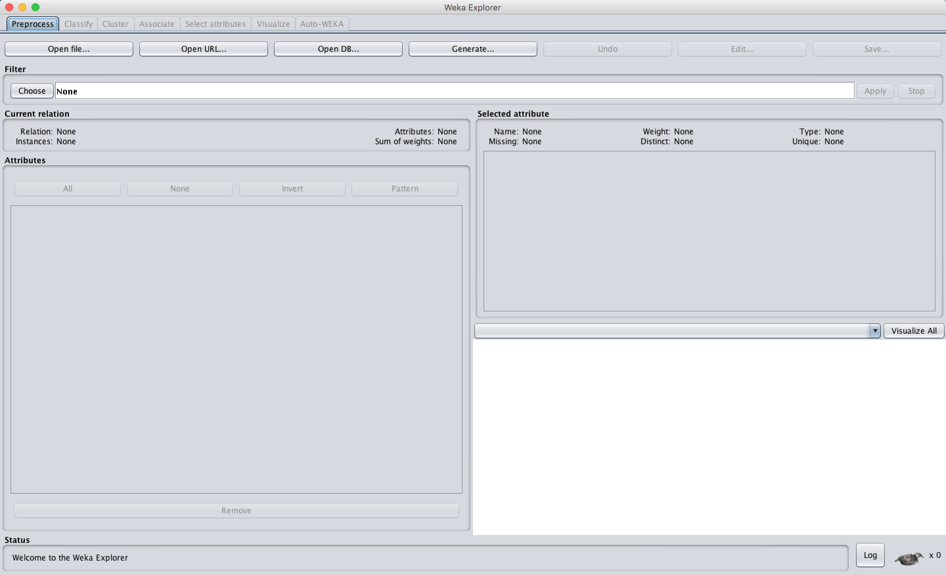
WEKA Explorer Mode - Properties
Both Attributes (X) and Classes (Y) can be of the following Types:
Numerical (numbers)
Nominal (1+ categories)
Date (considered Nominal)
Binary (2 categories only)
Lets all open up the Iris data set!

Slide 29
Let’s make a prediction

Slide 30
Recall Regression – Fitting a line to data
120
110
100
90
80
70
60
50
40
30
20
10
0
30 60 90 120 150

Slide 31
Recall Regression – Fitting a line to data
Select the “best” line that minimizes the distance of all points to the line.
Note “distance” can be measured in different ways
120
110
100
90
80
70
60
50
40
30
20
10
0
30 60 90 120 150

Slide 32
Binary Logistic Regression (LR) Finding a cutoff line between two classes
120
110
100
90
80
70
60
50
40
30
20
10
0
30 60 90 120 150

Slide 33
Binary Logistic Regression (LR) Finding a cutoff line between two classes
LR squeezes response values to be between 0-1.
1.0
0.75
0.50
0.25
0
30 60 90 120 150

Slide 34
Binary Logistic Regression (LR) Finding a cutoff line between two classes
LR squeezes response (Y) values to be between 0-1.
Here, any Y >= 0.7 would be classified as blue, and < 0.7 as red.
1.0
0.75
0.50
0.25
0
Note, by treating each response category separately,
“Multiple Logistic Regression” can consider more than 2 classes!
30 60 90 120 150

Slide 35
Breast Cancer Data Set
Breast cancer reoccurrence data from Zwitter and Soklic at the University Medical Centre, Institute of Oncology, Ljubljana, Yugoslavia.
Contains 9 attributes related to 286 patient instances.
Binary Class Response: “recurrence-events” or “no-recurrence-events”

Slide 36
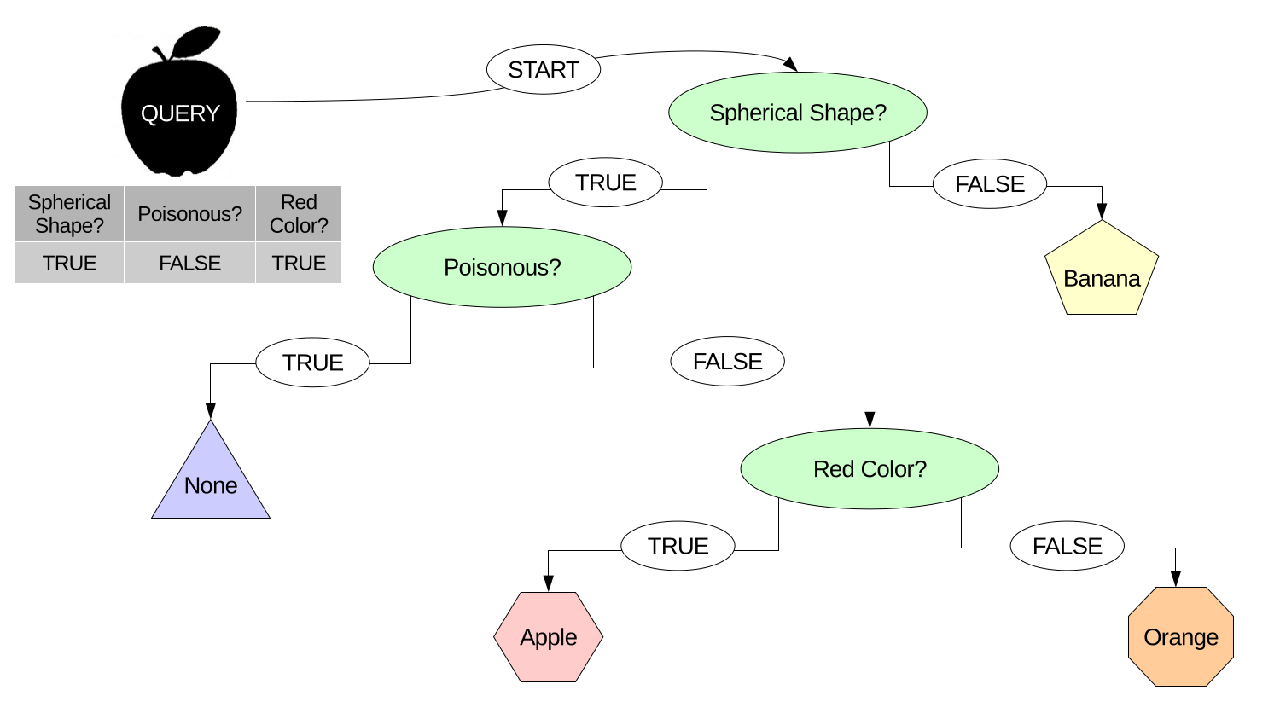
Decision Trees
Root
Nodes
Leaves
Branches
Notes:
Extra slides for more DT details

Slide 37
Diabetes Data Set
Data set from Smith et al. [1] from the 80’s from an early diabetes prediction algorithm paper,
Contains 8 numeric attributes for 768 patient samples (all females of Pima Indian heritage),
Binary response class: tested positive or negative for diabetes.

Slide 38
Support Vector Machine
Support vector machine (SVM) is a popular machine learning algorithm, often employed for classification and regression.
The algorithm tries to find the optimal hyperplane (boundary) that can separate two classes of data.
Here, “optimal” refers to the decision boundary with the widest distance between the closest points of each class- the support vectors.

Slide 39
A Linear SVM Example
Decision
Boundary
Support
Vectors
Margin

Slide 40
Attribute Selection – Sometimes less is more
Sometimes an attribute in your data set is not helpful for making predictions:
Perhaps it is not actually related to the problem?
It might be redundant if two variables are correlated and capture the same information?
The more attributes you have, the harder it is to understand your model. You may want to remove attributes that are not very important for good classifier performance or if your ML algorithm is very slow to run.
Only apply attribute selection to training data – do not using your testing set. Selecting attributes is part of the training process!

Slide 41
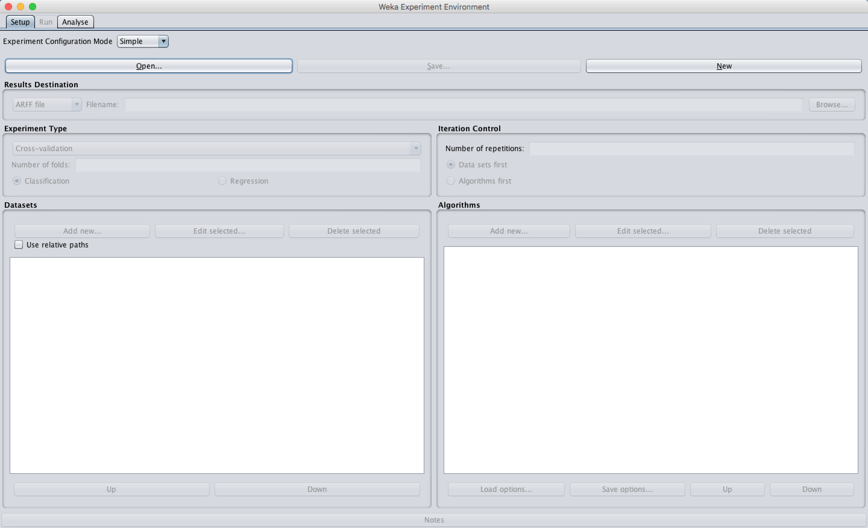
WEKA Experiment Environment
Used to more thoroughly test models and parameters!

Slide 42
Now Explore WEKA!
Use the data sets you have to explore WEKA – try out new classifiers and attribute selection modes!
www.dveltri.com/ACE
Optional Challenge: Ask Dan for a “challenge mode” data set!
Contains training and testing data from outdoor pictures
Input attributes are various features made of photo pixel information (e.g. average amount of red pixels etc.)
Response classes are 7 different scenery types: brickface, sky, foliage, cement, windows, paths, and grass
HINT: Its easy to do well on the training data, harder to do well on the testing set
Try to create the best performing model you can!
Image from: stickpng.com

Slide 43
Thank you!
If you have any questions feel free to email me:
Dan Veltri
daniel.veltri@nih.gov
https://github.com/niaid/bcbb-training-intro-to-machine-learning

Slide 44
Extra Slides

Slide 45
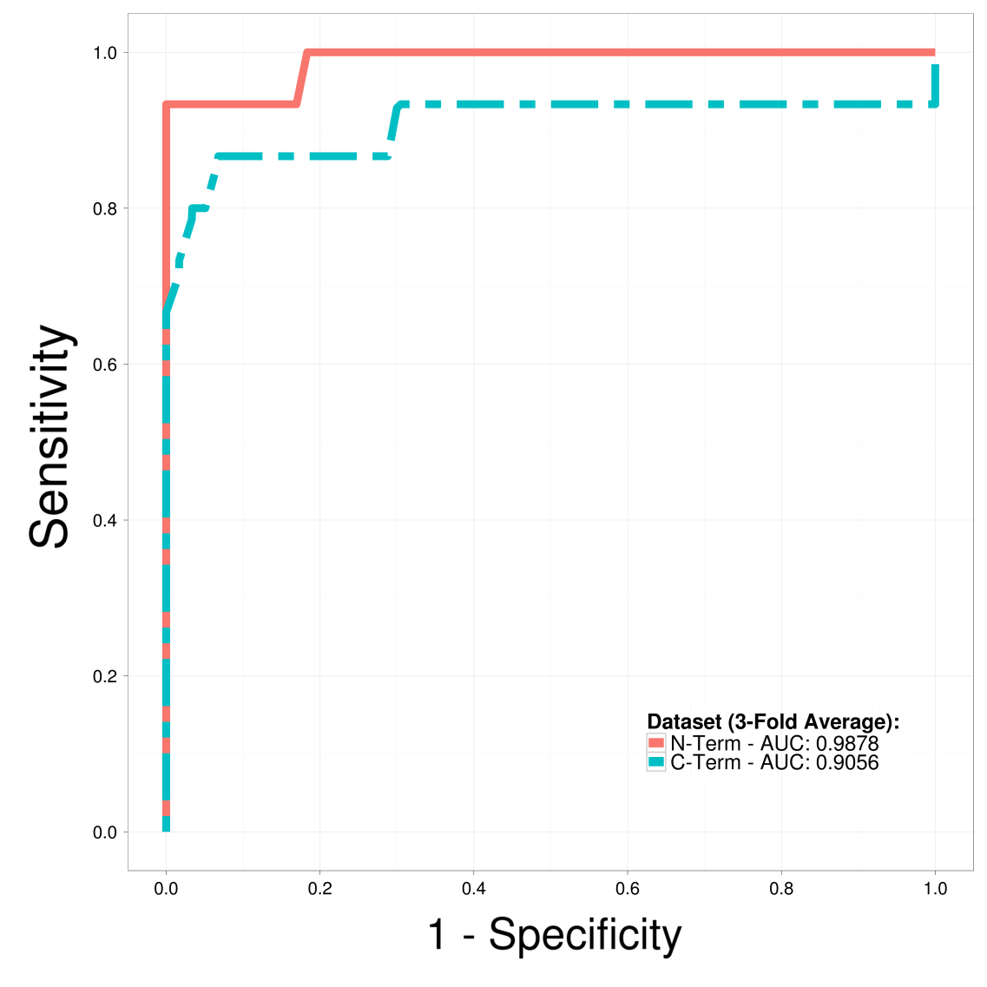
Receiver Operator Curve (ROC)
Better Performance
RANDOM GUESS
Wrong labels for data?

Slide 46
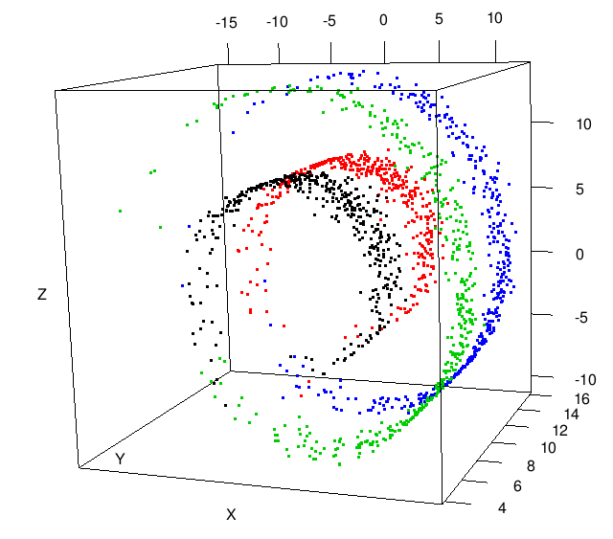
Dimensionality Reduction
You can try this yourself! Sample swiss roll data at:
http://people.cs.uchicago.edu/~dinoj/manifold/swissroll.html

Slide 47
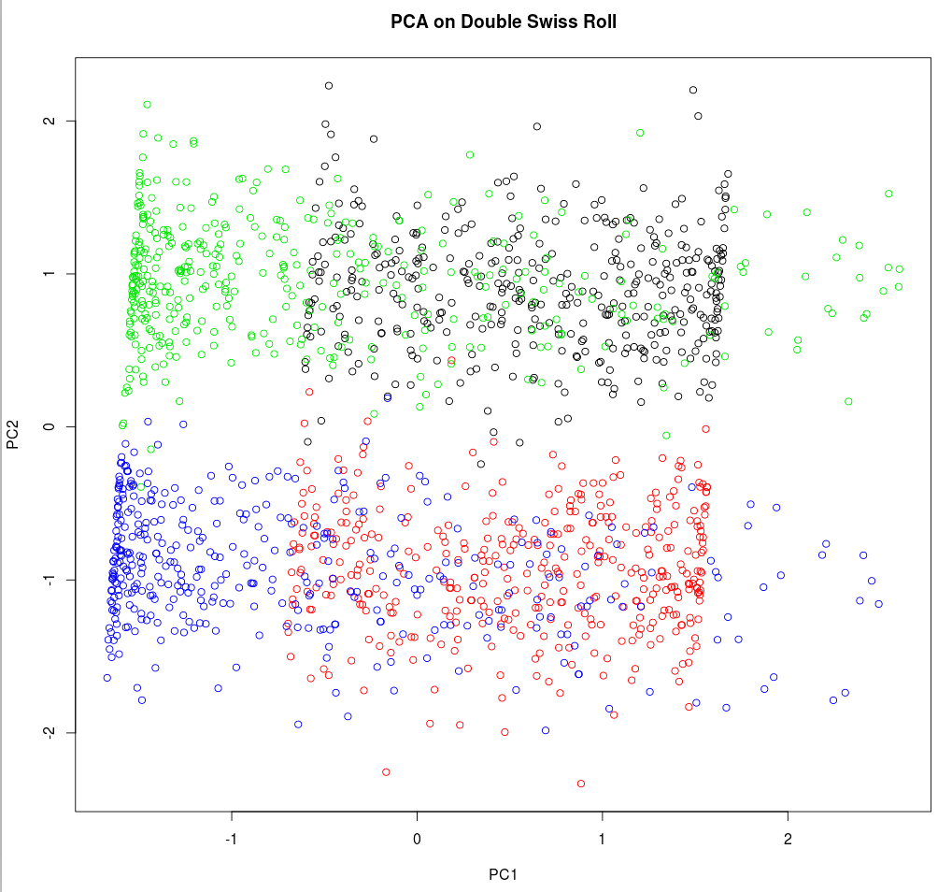
Principal Components Analysis

Slide 48
Logistic Regression (LR)
LR is a type of regression for binary prediction problems (the response classes are 0/1, TRUE/FALSE, etc.),
It provides a smooth probabilistic transition between the two classes while also controlling for over-fitting,
Output values are forced between [0,1]
Notes:
State we carefully select a diverse set of features for genereation 1.

Slide 49
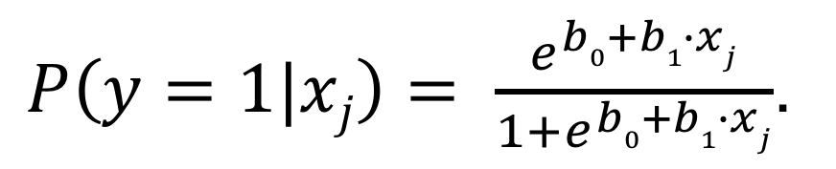
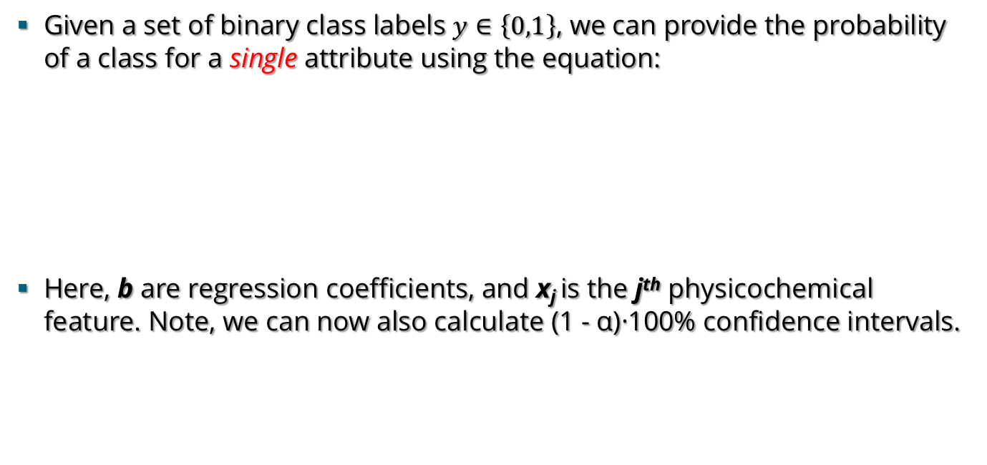
Model Construction with Logistic Regression
Given a set of binary class labels $y∈\left\{0,1\right\}$, we can provide the probability of a class for a single attribute using the equation:
Here, b are regression coefficients, and x_{j} is the j^{th} physicochemical feature. Note, we can now also calculate (1 - α)·100% confidence intervals.
$P\left(y=1|xj\right)= \frac{e^{b0+b1∙xj}}{1+e^{b0+b1∙xj}}$.

Slide 50
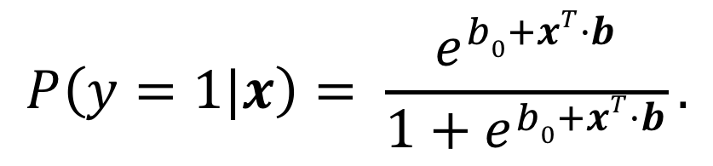
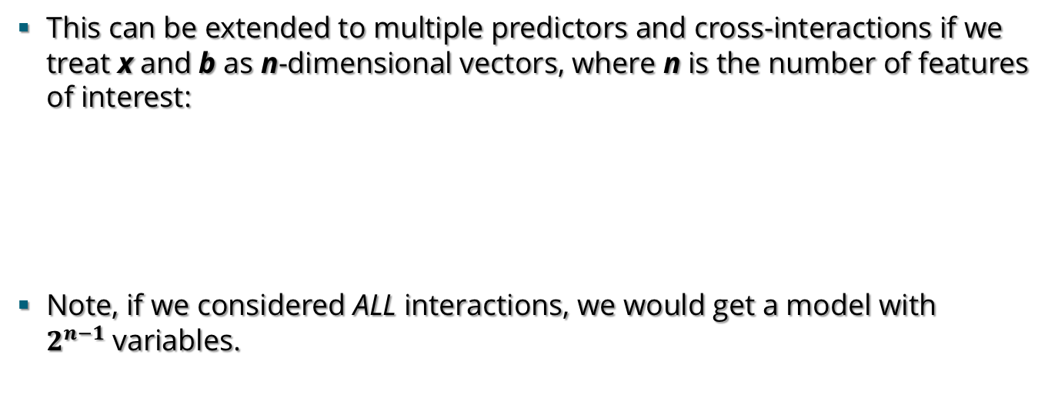
Model Construction with Logistic Regression
This can be extended to multiple predictors and cross-interactions if we treat x and b as n-dimensional vectors, where n is the number of features of interest:
Note, if we considered ALL interactions, we would get a model with $2^{n−1}$variables.
$$P\left(y=1|x\right)= \frac{e^{b0+xT·b}}{1+e^{b0+xT·b}}.$$

Slide 51
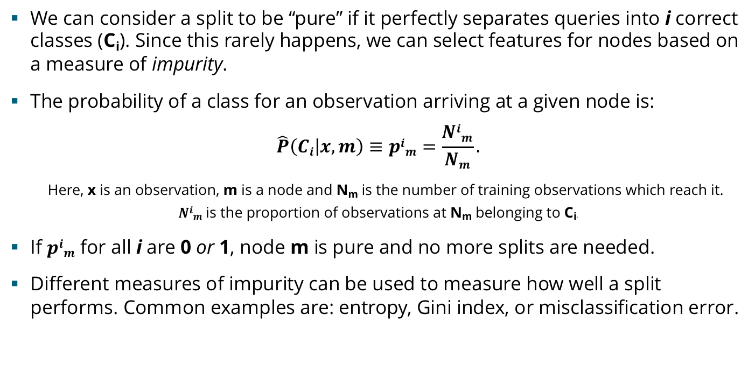
How Many Nodes/Splits in a Tree?
We can consider a split to be “pure” if it perfectly separates queries into i correct classes (C_{i}). Since this rarely happens, we can select features for nodes based on a measure of impurity.
The probability of a class for an observation arriving at a given node is:
$$\hat{P}\left(Ci | x,m\right)≡pim=\frac{Nim}{Nm}.$$
Here, x is an observation, m is a node and N_{m} is the number of training observations which reach it.
$Nim$ is the proportion of observations at N_{m} belonging to C_{i}.
If $pim$ for all i are 0 or 1, node m is pure and no more splits are needed.
Different measures of impurity can be used to measure how well a split performs. Common examples are: entropy, Gini index, or misclassification error.
51
Source: Alpaydin (2010) Intro to ML. MIT Press 2nd Ed. pp185-192.
Notes:
We may want to skip this slide unless asked about DT specifics
Entropy lm = - sum{1…k}(p_m^i log2(p_m^i)

Slide 52
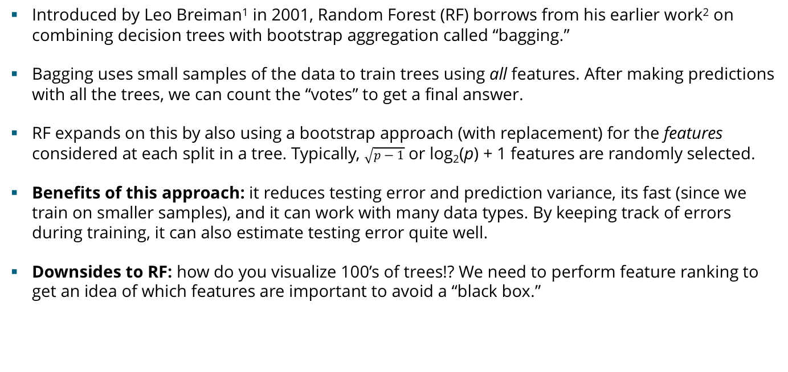
Random Forest® - An Ensemble of Trees
Introduced by Leo Breiman¹ in 2001, Random Forest (RF) borrows from his earlier work² on combining decision trees with bootstrap aggregation called “bagging.”
Bagging uses small samples of the data to train trees using all features. After making predictions with all the trees, we can count the “votes” to get a final answer.
RF expands on this by also using a bootstrap approach (with replacement) for the features considered at each split in a tree. Typically, $\sqrt{p−1}$ or log₂(p) + 1 features are randomly selected.
Benefits of this approach: it reduces testing error and prediction variance, its fast (since we train on smaller samples), and it can work with many data types. By keeping track of errors during training, it can also estimate testing error quite well.
Downsides to RF: how do you visualize 100’s of trees!? We need to perform feature ranking to get an idea of which features are important to avoid a “black box.”
DATA
VOTES
11 17
1
2
FEATURES
0
2
3
5
7
8
52
[1] Breiman (2001) Machine Learning 45(1):5-32. [2] Breiman (1994) Machine Learning 24(2):123-140.
Notes:
Note we’re talking about using RF for classification here (Cost functions: misclass error, IG[weka], Gini index[R], deviance)…
But mention you can also use them with regression (Cost func: squared error impurity)
Two params: #Trees, Mtry - Bagging is the same as Mtry = P
On values of Mtry:
Breiman Paper: log2(p – 1) + 1
Weka: log2(p) + 1
R: sqrt(p – 1)
Ensemble of learners

Slide 53
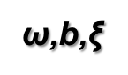
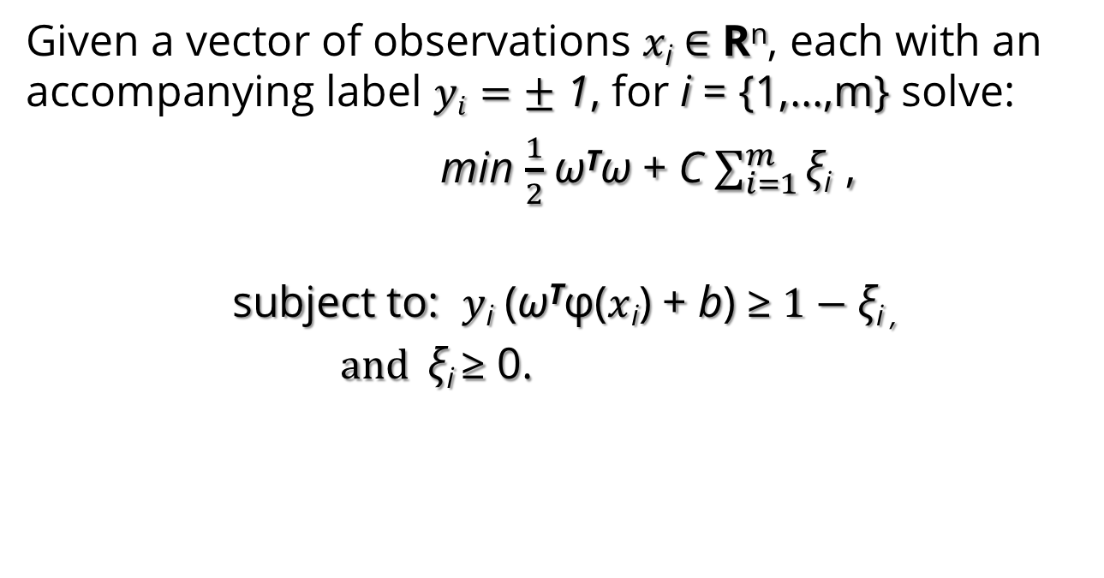
Support Vector Machine
Given a vector of observations $x\text{i}∈$ R^{n}, each with an accompanying label $yi=±$ 1, for i = {1,…,m} solve:
min $\frac{1}{2}$ ω^{T}ω + C $\sum_{i=1}^{m}{\text{ξ}}$_{i} ,
subject to: $y$_{i} (ω^{T}φ($x$_{i}) + b) ≥ $1−\text{ξ}$_{i ,}
$and \text{ξ}$_{i} $\text{≥ 0.}$
ω,b,$\text{ξ}$
Source: Cortes and Vapnik (1995) Support vector networks. Mach. Learn. 20(3):273:293.

Slide 54
Support Vector Machine
Given a vector of observations $x\text{i}∈$ R^{n}, each with an accompanying label $yi=±$ 1, for i = {1,…,m} solve:
min $\frac{1}{2}$ ω^{T}ω + C $\sum_{i=1}^{m}{\text{ξ}}$_{i} ,
subject to: $y$_{i} (ω^{T}φ($x$_{i}) + b) ≥ $1−\text{ξ}$_{i ,}
$and \text{ξ}$_{i} $\text{≥ 0.}$
ω,b,$\text{ξ}$
C is a cost function, a tuning parameter.
Source: Cortes and Vapnik (1995) Support vector networks. Mach. Learn. 20(3):273:293.

Slide 55
Support Vector Machine
Given a vector of observations $x\text{i}∈$ R^{n}, each with an accompanying label $yi=±$ 1, for i = {1,…,m} solve:
min $\frac{1}{2}$ ω^{T}ω + C $\sum_{i=1}^{m}{\text{ξ}}$_{i} ,
subject to: $y$_{i} (ω^{T}φ($x$_{i}) + b) ≥ $1−\text{ξ}$_{i ,}
$and \text{ξ}$_{i} $\text{≥ 0.}$
ω,b,$\text{ξ}$
$\text{ξ}$ is a soft error penalty for points that fall within the margin.
Source: Cortes and Vapnik (1995) Support vector networks. Mach. Learn. 20(3):273:293.

Slide 56
Support Vector Machine
Given a vector of observations $x\text{i}∈$ R^{n}, each with an accompanying label $yi=±$ 1, for i = {1,…,m} solve:
min $\frac{1}{2}$ ω^{T}ω + C $\sum_{i=1}^{m}{\text{ξ}}$_{i} ,
subject to: $y$_{i} (ω^{T}φ($x$_{i}) + b) ≥ $1−\text{ξ}$_{i ,}
$and \text{ξ}$_{i} $\text{≥ 0.}$
ω,b,$\text{ξ}$
φ is the “kernel trick,” a function to map data to a higher dimension.
Source: Cortes and Vapnik (1995) Support vector networks. Mach. Learn. 20(3):273:293.

Slide 57
Support Vector Machine
Given a vector of observations $x\text{i}∈$ R^{n}, each with an accompanying label $yi=±$ 1, for i = {1,…,m} solve:
min $\frac{1}{2}$ ω^{T}ω + C $\sum_{i=1}^{m}{\text{ξ}}$_{i} ,
subject to: $y$_{i} (ω^{T}φ($x$_{i}) + b) ≥ $1−\text{ξ}$_{i ,}
$and \text{ξ}$_{i} $\text{≥ 0.}$
ω,b,$\text{ξ}$
A prediction for $x$_{i} is made by the function: f(x) = sgn(ω^{T}φ($x$_{i}) + b).
Source: Cortes and Vapnik (1995) Support vector networks. Mach. Learn. 20(3):273:293.

Slide 58
SVM Computational Complexity
SVMs are solved as quadratic programing problems and performance depends greatly on the number of support vectors (S) required.
For training complexity is O(n²) . For n samples, verifying the best hyperplane requires nS operations and S is determined by the training set size and the error rate for training.
For testing, complexity ranges from O(n²) to O(n³).
Particularly when using the RBF Kernel, memory can be an issue for large problems as the size of the kernel matrix is n².
Source: Bordes, Ertekin and Weston (2005) Fast Kernel Classifiers with Online and Active Learning. Journal of Machine Learning Research 6:1579-1619.

Slide 59
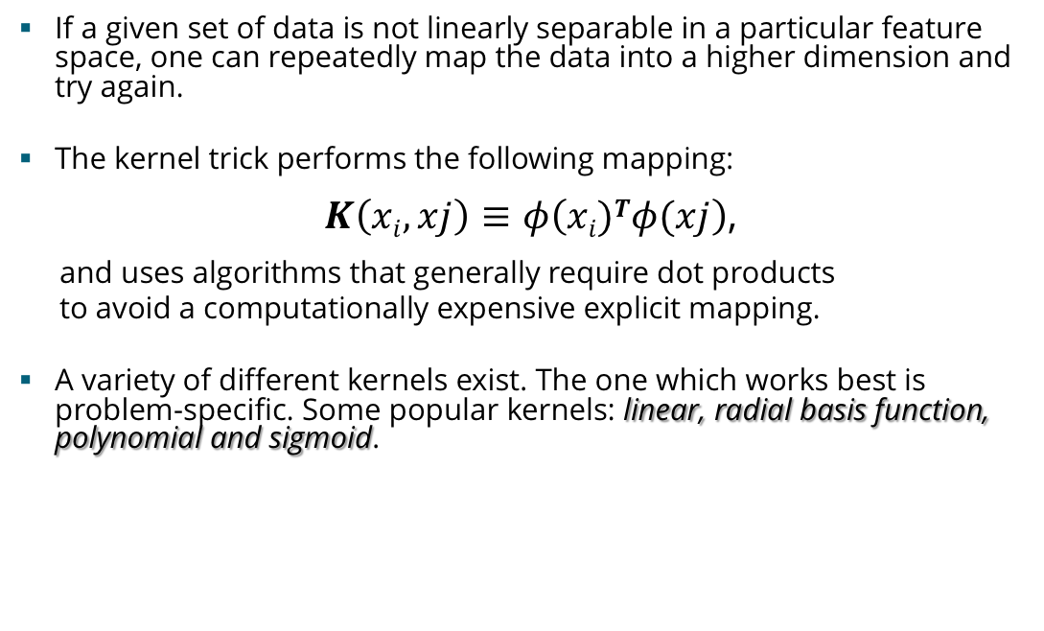
The Kernel Trick
If a given set of data is not linearly separable in a particular feature space, one can repeatedly map the data into a higher dimension and try again.
The kernel trick performs the following mapping:
$K\left(xi,xj\right)≡φ\left(xi)Tφ(xj\right)$,
and uses algorithms that generally require dot products
to avoid a computationally expensive explicit mapping.
A variety of different kernels exist. The one which works best is problem-specific. Some popular kernels: linear, radial basis function, polynomial and sigmoid.

Slide 60
Example: Data May Become Linearly Separable in a Higher Dimension
We start with the data in a given input space.
Now the data has become linearly separable.
Next we apply a “kernel trick” to map the data into a new feature space.

Slide 61
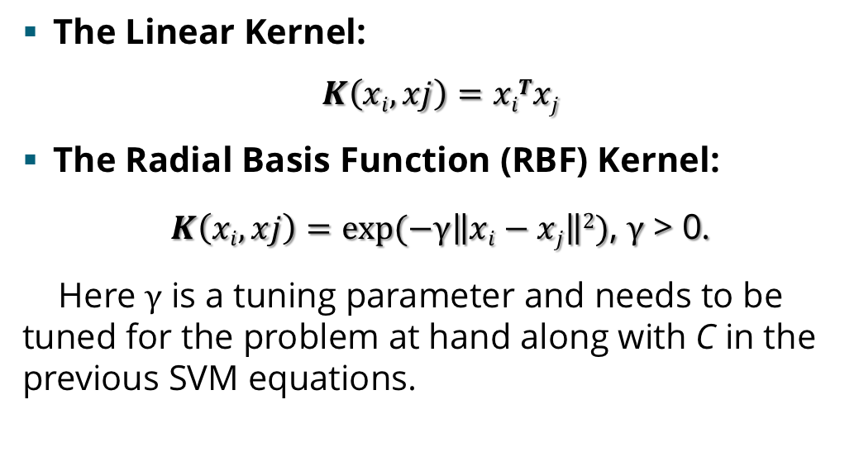
Two Popular Kernels
The Linear Kernel:
$$K\left(xi,xj\right)=xiTxj$$
The Radial Basis Function (RBF) Kernel:
$K\left(xi,xj\right)=exp⁡(−γ\left\|xi−xj\right\|2)$, $γ$ > 0.
Here $γ$ is a tuning parameter and needs to be tuned for the problem at hand along with C in the previous SVM equations.

